Slide 1
Angular NgRx
NgRx Introduction
Lecture 1
By James(Jin) Wang
10/08/2022

Slide 2
Course Overview
Introduction
The Redux Pattern
First Look at NgRx
Strongly Typing the State
Strongly Typing Actions with Action Creators
Working with Effects
Perform Update Operations

Slide 3
Outline
Introduction
What is NgRx?
Why use NgRx?

Slide 4
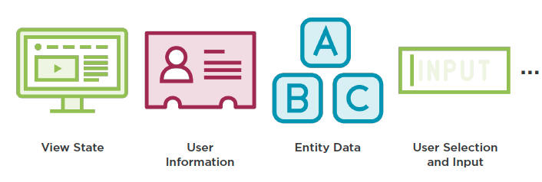
Introduction
  What is State?

Slide 5
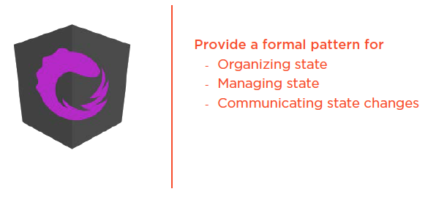
Introduction
  Purpose of NgRx

Slide 6
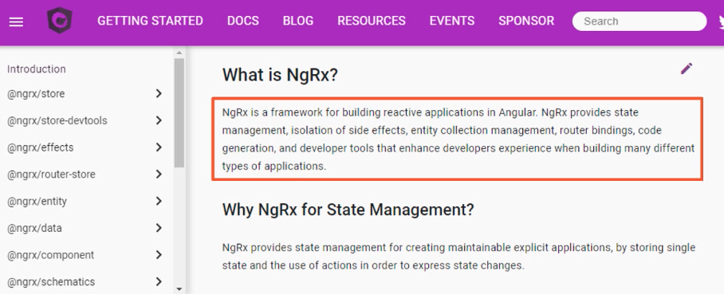
Introduction
  What is NgRx?

Slide 7
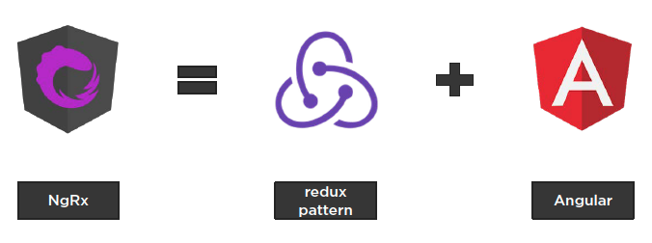
Introduction
  What is NgRx?

Slide 8
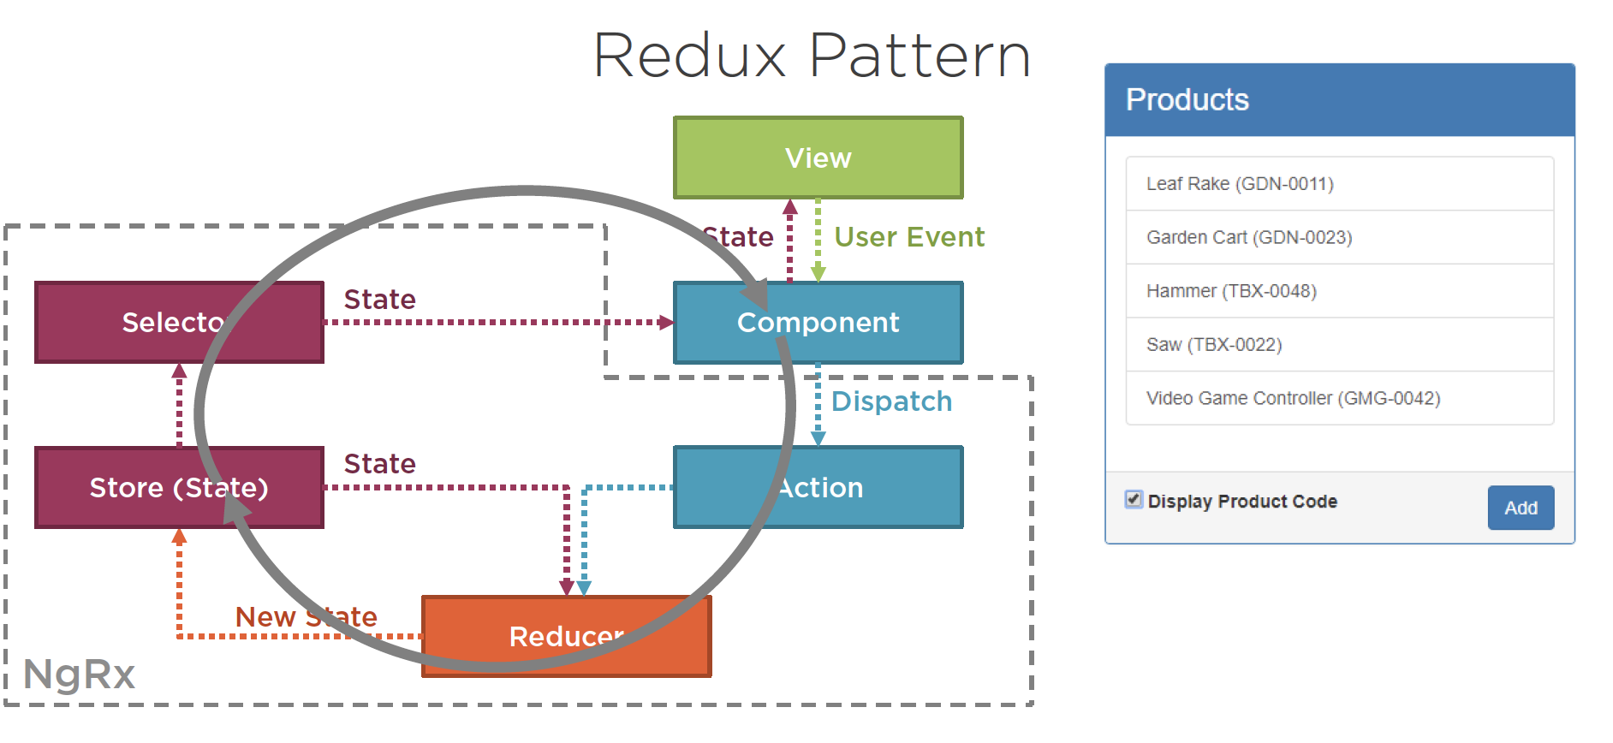
Introduction
  Redux Pattern

Slide 9
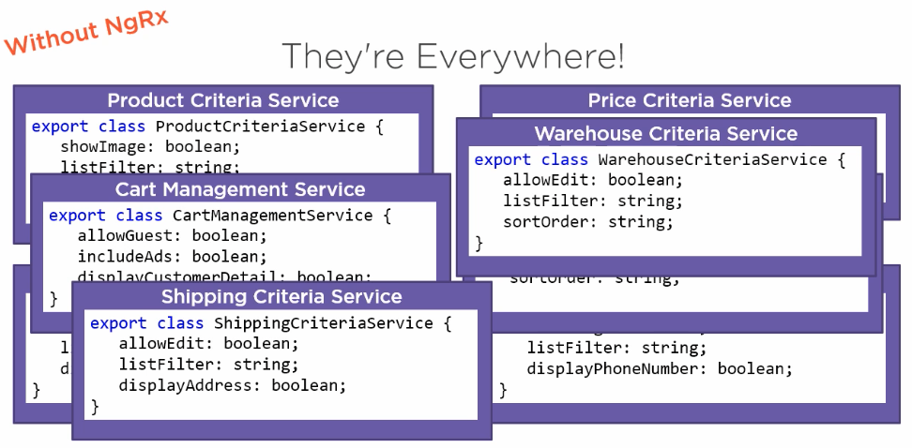
Introduction
  Why Use NgRx?

Slide 10
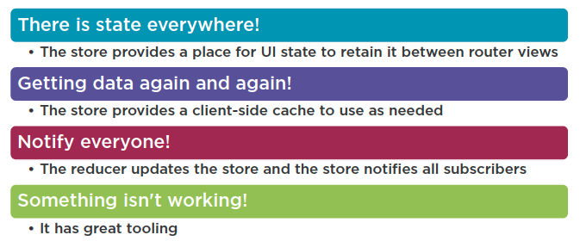
Introduction
  Use NgRx When…

Slide 11
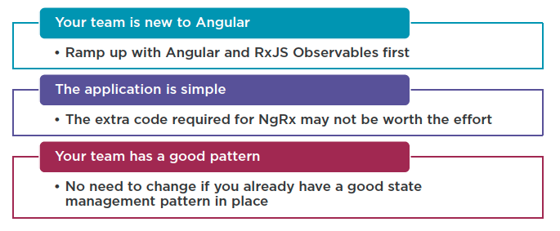
Introduction
  Don’t use NgRx When…

Slide 12
Reference
Angular NgRx: Getting Started
https://app.pluralsight.com/library/courses/angular-ngrx-getting-started/table-of-contents
Play by Play: Angular and ngrx
https://app.pluralsight.com/library/courses/play-by-play-angular-ngrx/table-of-contents

Slide 13
Summary

